Slide 1
CS4101 嵌入式系統概論 Interrupt and DAC
Prof. Chung-Ta King
Department of Computer Science
National Tsing Hua University, Taiwan

Slide 2
Outline
Interrupts on Arduino
Digital-to-analog converter (DAC) and Pulse-width modulation (PWM)
ADC on Arduino UNO
Sensors
Actuation by stepper motor

Slide 3
Arduino Interrupts
Interrupts can be generated from several sources:
Timer interrupts from one of the Arduino timers, which interrupt us once per several milliseconds
External interrupts from a change in state of one of the external interrupt pins
Pin-change interrupts from a change in state of any one of a group of pins
Interrupt programming:
ISR(interrupt vector): interrupt routine definition
reti(): return from interrupt, automatically generated for ISR

Slide 4
Recall Arduino Timers
3 timers that count from the 16MHz system clock:
Timer0: 8-bit timer used by delay(), millis(), micros()
Timer1: 16-bit timer used by the Servo() library
Timer2: 8-bit timer used by the Tone() library
Timer1:
The timer/counter register (TCNT1): c.f. TA0R
2 output compare registers (OCR1A, OCR10B): c.f. TA0CCRx
Input capture register (ICR1): c.f. TA0CCRx
Control registers:
Timer/counter control registers (TCCR1A/B/C, 8-bit)
Timer/counter interrupt flag register (TIFR1)
Timer/counter interrupt mask register (TIMSK1)

Slide 5
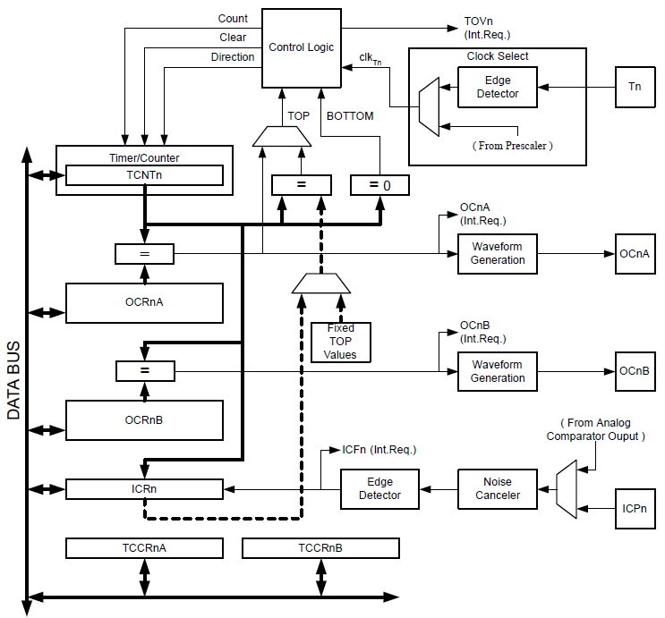
Recall ATmega328 Timer Block Diagram

Slide 6
ATmega328 Interrupts

Slide 7
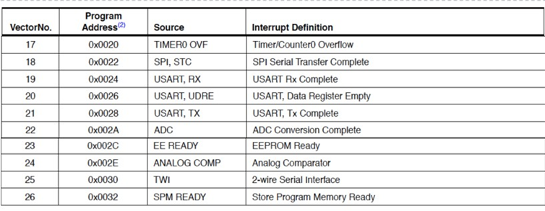
ATmega328 Interrupts (cont.)

Slide 8
ATmega328 Interrupt Vectors of ISR
#define INT0_vect _VECTOR(1) /* External Interrupt Request 0 */
#define INT1_vect _VECTOR(2) /* External Interrupt Request 1 */
#define PCINT0_vect _VECTOR(3) /* Pin Change Interrupt Request 0 */
#define PCINT1_vect _VECTOR(4) /* Pin Change Interrupt Request 0 */
#define PCINT2_vect _VECTOR(5) /* Pin Change Interrupt Request 1 */
#define WDT_vect _VECTOR(6) /* Watchdog Time-out Interrupt */
#define TIMER2_COMPA_vect _VECTOR(7) /* Timer/Counter2 Compare Match A */
#define TIMER2_COMPB_vect _VECTOR(8) /* Timer/Counter2 Compare Match A */
#define TIMER2_OVF_vect _VECTOR(9) /* Timer/Counter2 Overflow */
#define TIMER1_CAPT_vect _VECTOR(10) /* Timer/Counter1 Capture Event */
#define TIMER1_COMPA_vect _VECTOR(11) /* Timer/Counter1 Compare Match A */
#define TIMER1_COMPB_vect _VECTOR(12) /* Timer/Counter1 Compare Match B */
#define TIMER1_OVF_vect _VECTOR(13) /* Timer/Counter1 Overflow */
#define TIMER0_COMPA_vect _VECTOR(14) /* TimerCounter0 Compare Match A */
#define TIMER0_COMPB_vect _VECTOR(15) /* TimerCounter0 Compare Match B */
... ...

Slide 9
Sample Code for Interrupt with IRS()
Flash the LED connected to pin 13 at 1 Hz using CTC mode by interrupt routine
int toggle;
void setup() {
pinMode(13, OUTPUT);
cli(); // stop interrupts, atomic access to reg.
// initialize timer1
TCCR1A = 0; TCCR1B = 0; TCNT1 = 0;
TCCR1B |= (1 << WGM12); // turn on CTC
TCCR1B |= (1<<CS12) | (1<<CS10); // 1024 prescaler
OCR1A = 7812; // target for counting
TIMSK1 |= (1<<OCIE1A); // enable timer compare int.
sei(); // enable all interrupts
}
Check L09 for timer registers
Notes:
(16,000,000/1024)*0.5 sec – 1 = 7812
TIMSK1: timer/counter interrupt mask register
OCIE1A: output compare A match interrupt enable

Slide 10
Sample Code for Interrupt with ISR()
ISR(TIMER1_COMPA_vect) { // Timer1 ISR
if (toggle) {
digitalWrite(13, HIGH);
toggle = 0 ;
} else {
digitalWrite(13, LOW);
toggle = 1;
}
}
void loop() {
...
}
Executed whenever timer compare matches OCR1A

Slide 11
Arduino External Interrupts
Two digital pins can be used for external interrupts
INT0 is mapped to Pin2
INT1 is mapped to Pin3
Other pins can be monitored by pin change interrupts
Functions for external interrupts:
attachInterrupt(interrupt, function, mode)
interrupt: 0 or 1 for INT0 or INT1
function: interrupt function to call
mode: LOW, CHANGE, RISING, FALLING
detachInterrupt(interrupt)
interrupts( ): enable interrupts, i.e. sei( )
noInterrupts( ): disable interrupts, i.e. cli( )

Slide 12
Mode in attachInterrupt()
LOW:
Trigger the interrupt whenever the pin is low
CHANGE:
Trigger the interrupt whenever the pin changes value
RISING:
Trigger when the pin goes from low to high
FALLING:
Trigger when the pin goes from high to low

Slide 13
Sample Code for External Interrupts
Button click switches LED; button connected to pin 2
int led_pin = 13;
int button_int = 0; // INT0 is on pin 2
int toggle_on = false; // Button click switches LED
void setup() {
attachInterrupt(button_int, handle_click, RISING);
// Register handler
}
void loop() {
if (toggle_on) {
digitalWrite(led_pin, HIGH);
} else {
digitalWrite(led_pin, LOW);
}
}

Slide 14
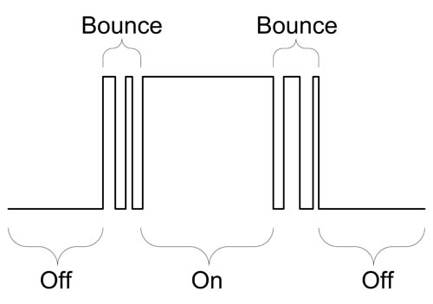
Sample Code for External Interrupts
// button ISR
void handle_click() { // button debouncing, toggle LED
static unsigned long last_int_time = 0;
unsigned long int_time = millis(); // Read the clock
if (int_time - last_int_time > 200 ) {
// Ignore when < 200 msec
toggle_on = !toggle_on; // switch LED
}
last_int_time = int_time;
}
Notes:
Non-blocking: unsigned long millis()
Returns the number of milliseconds since the current program started

Slide 15
Outline
Interrupts on Arduino
Digital-to-analog converter (DAC) and Pulse-width modulation (PWM)
ADC on Arduino UNO
Sensors
Actuation by stepper motor

Slide 16
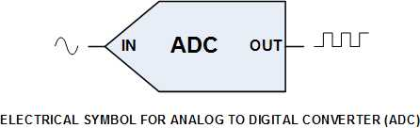
Analog and Digital Conversion
We have learned that we can quantify a nature value by ADC.
We can also transform digital value into analog signals, e.g. control motors, generate sounds, ...
Analog signal
Digital signal
Analog signal
DAC
Binary input
IN
OUT

Slide 17
Digital-to-Analog Converter (DAC)
DAC converts digital values into analog signals by producing different proportions of voltage according to the binary input.
Voltage can be generated by modifying different resistors
V_{ref}
V₁
R
V₂
2R
I
Rf
V₃
4R
-
V_{out}
+
V_{n}
2^{n-1}R
MSB
LSB
(D. Hinckley, L. Huynh, D. Kim)
Notes:
inverting summer Op Amp circuit

Slide 18


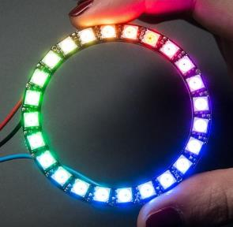
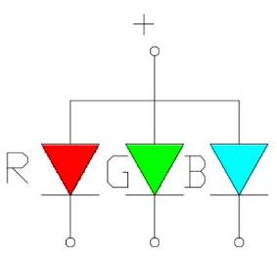
DAC Example – RGB LED
If we give LED more power, it will be brighter. So we can use this feature to intensify Red, Blue and Green diode through a DAC.

Slide 19
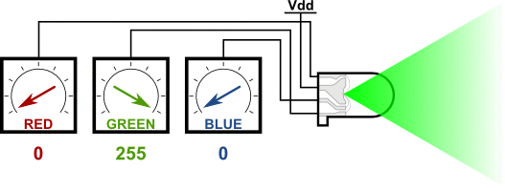
RGB LED Animation
Reference: Matthew Beckler's Home Page (https://www.mbeckler.org/microcontrollers/rgb_led/)

Slide 20
Pulse-width Modulation (PWM) for DAC
We can use DAC to control the output voltage, but this usually requires additional circuits:
Pulse-width modulation (PWM) provides the ability to simulate varying levels of outputs, e.g. to convert digital signals into analog intensities without DAC.
V_{ref}
V₁
R
V₂
2R
I
Rf
V₃
4R
-
V_{out}
+
V_{n}
2^{n-1}R

Slide 21
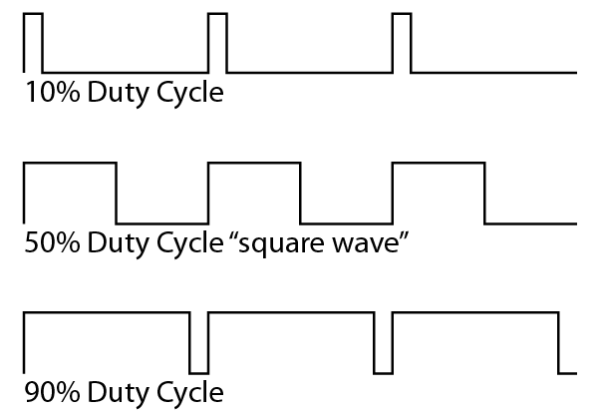
Pulse-width Modulation
A PWM signal:
Use pulses of different widths to provide diff. average power.
Duty Cycle = (PW/T) * 100% = T_{on} / (T_{on} + T_{off}) * 100%
where PW is pulse width time and T is total period of a signal.
Ex.: A 90% duty cycle means the signal is high 90% of the time and low 10% of the time.
Can be generated simply by a timer connected to a pin (e.g. OC1A in p. 45 of Lecture 9).
T
PW
http://wiki.bildr.org/index.php?title=Duty_Cycle

Slide 22
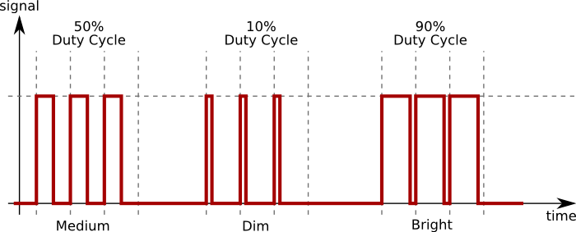
Example of Duty Cycle
If high voltage = 5 V and duty cycle = 10%, then the average output voltage = 0.5 V

Slide 23
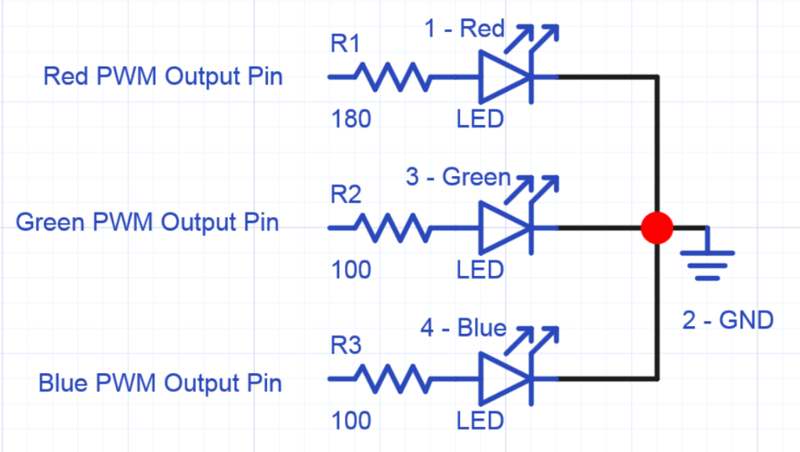
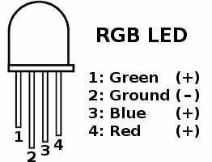
PWM for Driving RGB LED
(https://developer.mbed.org/users/4180_1/notebook/rgb-leds/)
(https://www.pjrc.com/teensy/rgb_led.gif)

Slide 24
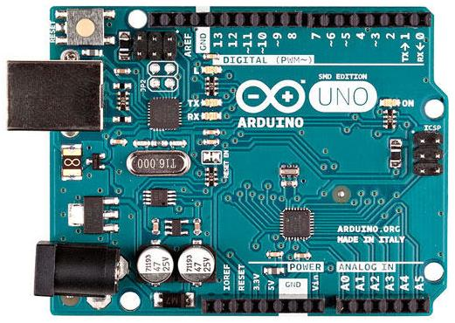
PWM in Arduino
6 pins, 3, 5, 6, 9, 10, 11, marked by ~ can produce PWM output via analogWrite(pinNumber, dutyCycle)

Slide 25
PWM in Arduino - analogWrite()
analogWrite(pin, value)
Writes an analog value (PWM wave) to a pin.
Value specifies the duty cycle between 0 (always off) and 255 (always on).
Pin will generate a steady square wave of the specified duty cycle until the next call to analogWrite().
The frequency of the PWM signal on most pins is approximately 490 Hz.
On Arduino UNO, pins 5 and 6 have a frequency of approximately 980 Hz.
Notes:
http://garretlab.web.fc2.com/en/arduino/inside/arduino/wiring_analog.c/analogWrite.html

Slide 26
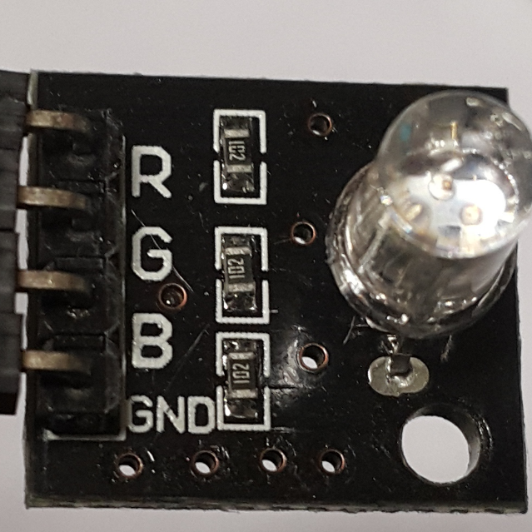
RGB LED Module
Connect to PWM pins
(pins with a ‘~’ notation)
Since the RGB mini board already contains built-in resistors, you
can connect to Arduino Uno directly.

Slide 27
Sample Code for RGB LED
int redPin = 11, greenPin = 10, bluePin = 9;
void setup() {
pinMode(redPin, OUTPUT);
pinMode(greenPin, OUTPUT);
pinMode(bluePin, OUTPUT);
}
void loop() {
analogWrite(redPin, 50);
analogWrite(greenPin, 100);
analogWrite(bluePin, 150);
delay(1000);
analogWrite(redPin, 0);
analogWrite(greenPin, 0);
analogWrite(bluePin, 0);
delay(1000);
}

Slide 28
Outline
Interrupts on Arduino
Digital-to-analog converter (DAC) and Pulse-width modulation (PWM)
ADC on Arduino UNO
Sensors
Actuation by stepper motor

Slide 29
ADC on Arduino UNO
6 analog input pins (A0 to A5), each can measure between 0 to 5V with 10-bit of resolution and accessed by analogRead(pinNumber)

Slide 30
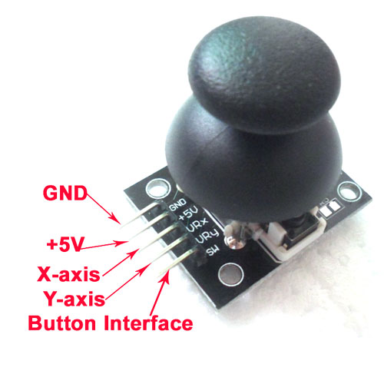
Analog Joystick as Inputs
(analog)
(digital)

Slide 31
Sample Code for Analog Joystick
int button = 2;
int xAxis = A0, yAxis = A1;
void setup() {
Serial.begin(9600);
pinMode(button, INPUT_PULLUP); //return LOW when down
}
void loop() {
int xVal = analogRead(xAxis);
int yVal = analogRead(yAxis);
int isPress = digitalRead(button);
Serial.print("X="); Serial.print(xVal);
Serial.print("Y="); Serial.print(yVal);
if(isPress == 0) Serial.print("Button is pressed.");
else Serial.print("Button is not pressed.");
delay(200);
}
Notes:
INPUT_PULLUP: Use built-in 20K pullup resistors in the Atmega chip, which effectively inverts the behavior of the INPUT mode, where HIGH means the sensor is off, and LOW means the sensor is on. When connecting a sensor to a pin configured with INPUT_PULLUP, the other end should be connected to ground. In the case of a simple switch, this causes the pin to read HIGH (pull-up to 5V) when the switch is open, and LOW when the switch is pressed.

Slide 32
Outline
Interrupts on Arduino
Digital-to-analog converter (DAC) and Pulse-width modulation (PWM)
ADC on Arduino UNO
Sensors
Actuation by stepper motor

Slide 33
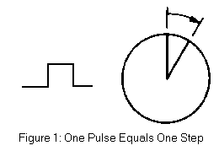

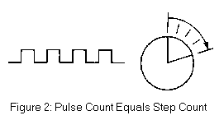
Stepper Motor
An electromagnetic device that
Converts digital pulses into mechanical shaft rotation
Ex. analog clock
Precision
Determined primarily by the number of steps per revolution
(coecsl.ece.illinois.edu/ge423/sensorprojects/StepMotor.ppt)

Slide 34
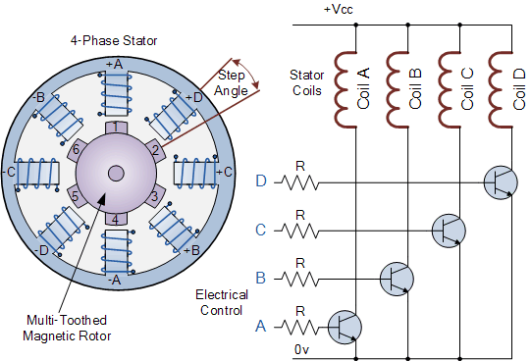
Stepper Motor
Controlled by a series of electromagnetic coils
The coils are alternately given current (via PWM or DAC).
The creating magnetic fields will repulse or attract the magnets on the shaft, causing the motor to rotate.
(http://www.electronics-tutorials.ws/io/io_7.html)

Slide 35
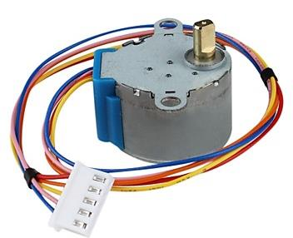
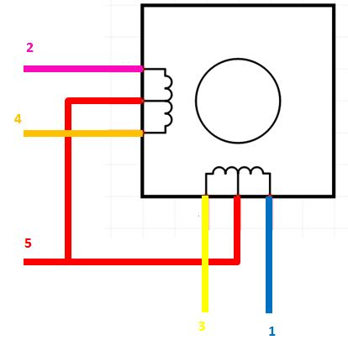
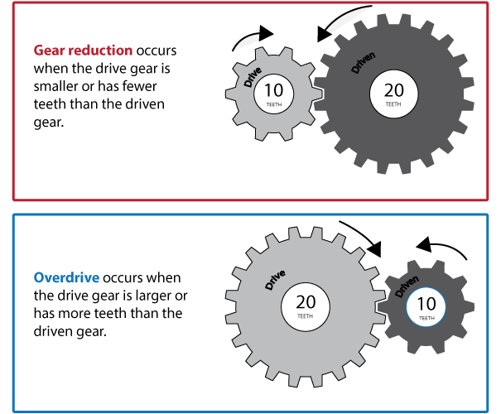
Example Stepper Motor: 28BYJ-48
Number of phases: 4
Step angle:
8-step: 5.625° (64 steps per revolution)
4-step: 11.25° (32 steps per revolution)
Gear reduction ratio: 1/64
32*64 = 2048 steps per revolution in 4-step sequence
NOTE:
Arduino "Stepper Library" runs in 4-step mode

Slide 36
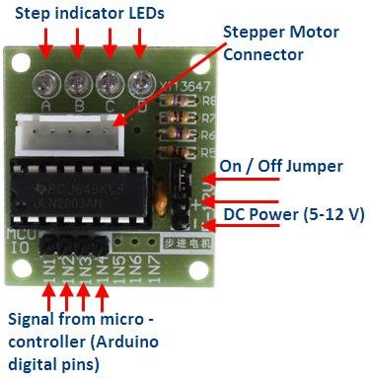
Stepper Motor Driver
The output voltage provided by Arduino UNO cannot drive 28BYJ-48.
So we need to use an amplifier, ULN2003, to raise the output voltage.
4 LEDs indicate which coil is currently powered
Choose 4 pins as input

Slide 37
Sample Code for Stepper Motor
#include <Stepper.h>
// for 28BYJ-48
#define STEPS 2048
// create an instance of stepper class, specifying #
// of steps of the motor and the pins attached to
Stepper stepper(STEPS, 8, 10, 9, 11);
// the previous reading from the analog input
int previous = 0;
void setup() {
stepper.setSpeed(30); // set the speed to 30 RPMs
}

Slide 38
Sample Code for Stepper Motor
void loop() {
// get the sensor value from pin A0
int val = analogRead(A0);
// move a number of steps equal to the change in the
// sensor reading
stepper.step(val - previous);
// remember the previous value of the sensor
previous = val;
}

Slide 39
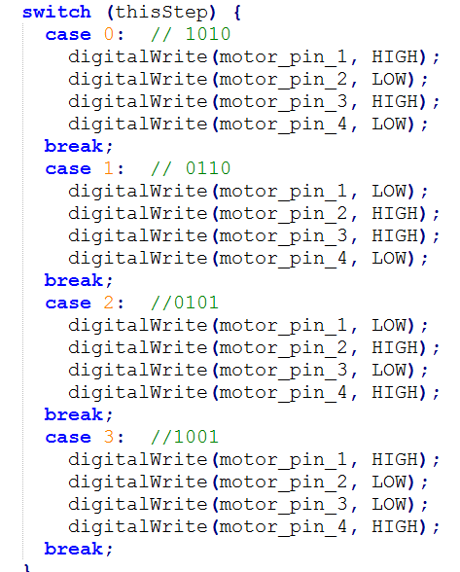
Stepper.c
Arduino stepper library uses 2-phase excitation to rotate the motor.

Slide 40
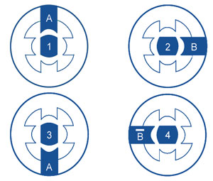
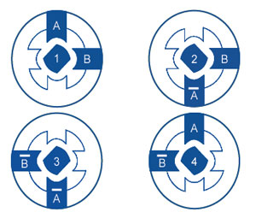
Drive Methods
Different drive methods for stepper motors.
Different methods cause different shakiness, power consumption and accuracy.
1-phase excitation
2-phase excitation

Slide 41
Outline
Interrupts on Arduino
Introduction to digital-to-analog converter (DAC)
DAC by Pulse-width modulation (PWM)
ADC on Arduino UNO
Sensors
Photoresistors, ultrasonic sensors, microphone
Actuation by stepper motor

Slide 42
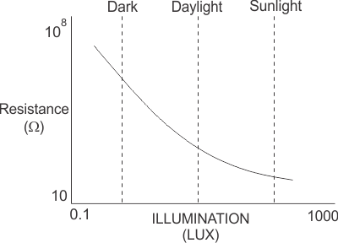
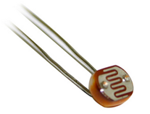
Photoresistor
Photoresistor is a light-controlled variable resistor
The resistance of a photoresistor decreases with increasing incident light intensity
In the dark, a photoresistor can have a resistance as high as several megohms (MΩ)
While in the light, a photoresistor can have a resistance as low as a few hundred ohms

Slide 43
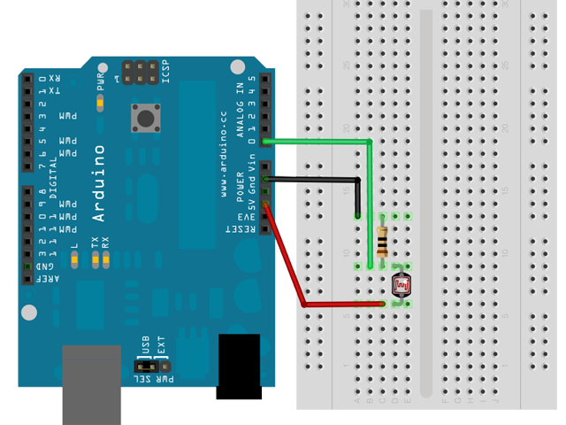
Photoresistor and Arduino

Slide 44
Sample Code for Photoresistor
void setup() { Serial.begin(9600); pinMode(A0, INPUT); pinMode(13, OUTPUT); digitalWrite(13, LOW); }
int pr_min = 400; void loop() { int pr = analogRead(A0);
/* Read value of A0 input (must in range of 0~1023) */
Serial.println(pr); digitalWrite(13, pr > pr_min ? LOW : HIGH);
/* If input value > pr_min, then turn on LED */
delay(1000); }
Analog input (0~5V) with 10-bit ADC
Notes:
Reads the value from the specified analog pin. The Arduino Uno board contains a 6 channel, 10-bit analog to digital converter. It will map input voltages between 0 and 5 volts into integer values between 0 and 1023. This yields a resolution between readings of: 5 volts / 1024 units or, .0049 volts (4.9 mV) per unit. The input range and resolution can be changed using analogReference().
It takes about 100 microseconds (0.0001 s) to read an analog input, so the maximum reading rate is about 10,000 times a second.

Slide 45
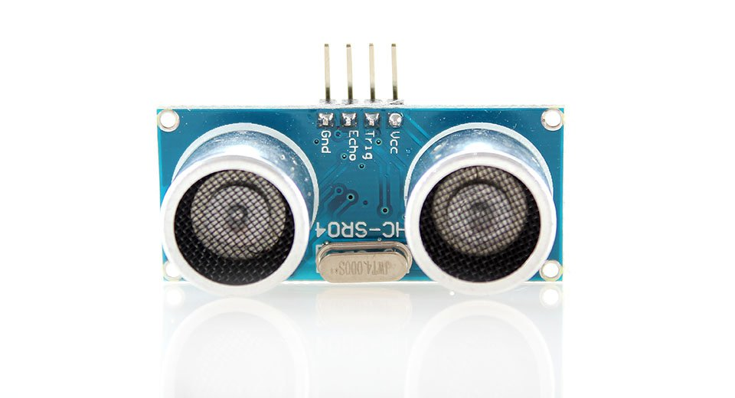
Ultrasonic Sensor
An ultrasonic sensor emits an ultrasound that travels through the air. If there is an object or obstacle on its path, it will bounce back to the sensor
Considering the travel time and the speed of the sound, the distance can be calculated
Ex.: HC-SR04
Effectual angle: <15°
Ranging distance: 2cm – 500 cm
Resolution: 0.3 cm
40KHz ultrasonic signal
4 pins: Vcc, Trig, Echo, GND

Slide 46
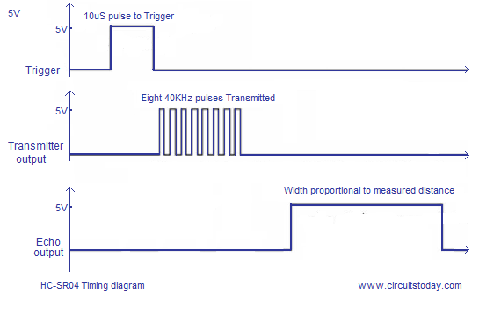
Distance Calculation
Set the Trig pin on at HIGH for > 10 µs to start
That will send out an 8-cycle sound wave that can be received in the Echo pin
Echo pin will be HIGH based on the time in microseconds that the sound wave traveled
Distance = HIGH Duration*(Sonic:340m/s)/2
HC-SR04 Timing Diagram
Trigger Pin
10 µs tripper pulse
Transmit Wave
8 x 40kHz sound wave
Echo Pin
Width proportional to measured distance

Slide 47
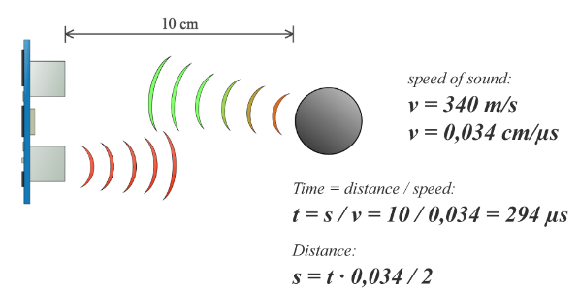
Distance Calculation: Example
So in order to get the distance in cm we need to multiply the received travel time value from the Echo pin by 0.034 cm/µs and divide it by 2

Slide 48
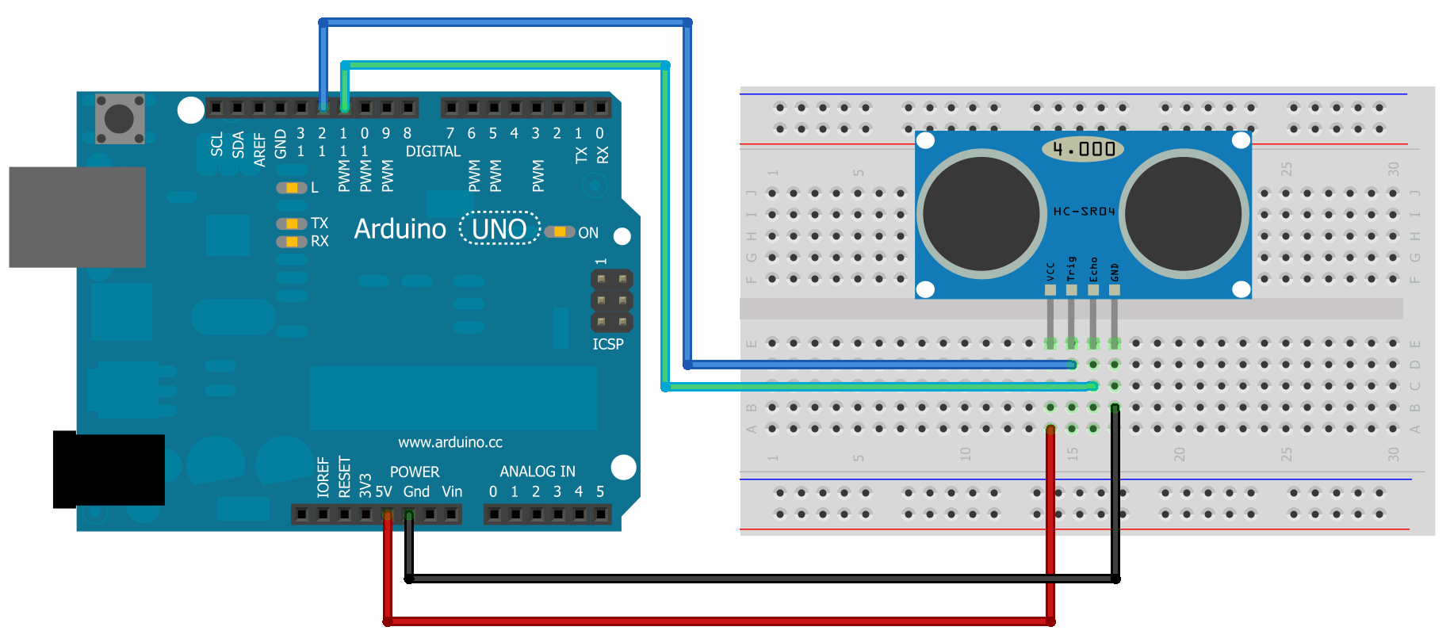
Ultrasonic Sensor and Arduino
HC-SR04 has 4 pins: Ground, Vcc, Trig, Echo
Vcc is connected to the 5 volt pin, trig and echo pins to any digital I/O pin on Arduino Uno

Slide 49
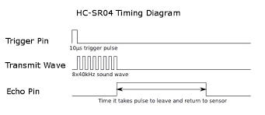
Ultrasonic Sensor and Arduino
pulseIn()reads a pulse (either HIGH or LOW) on a pin
Syntax : pulseIn(pin, value)
If value is HIGH, pulseIn() waits for the pin to go HIGH, starts timing, then waits for the pin to go LOW and stops timing
Returns the length of the pulse in microseconds or 0 if no complete pulse was received within the timeout
Echo Pin
Time it takes pulse to leave and return to sensors

Slide 50
Sample Code for Ultrasonic Sensor
const int trigPin = 12, echoPin = 11;
long duration, distance;
void setup() {
pinMode(trigPin, OUTPUT);
pinMode(echoPin, INPUT);
}
void loop() {
digitalWrite(trigPin, LOW); // Clears the trigPin
delayMicroseconds(2);
/* Sets the trigPin on HIGH state for 10 ms */
digitalWrite(trigPin, HIGH); delayMicroseconds(10);
digitalWrite(trigPin, LOW);
/* Reads Echo pin, returns sound travel time in ms */
duration = pulseIn(echoPin, HIGH);
/* Calculates the distance */
distance = duration*0.034/2;
}

Slide 51
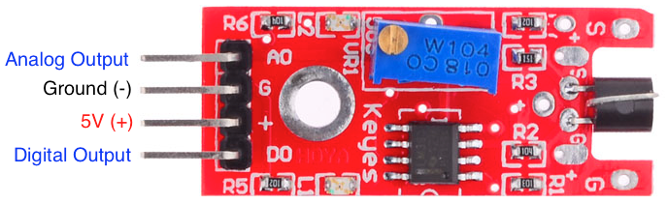
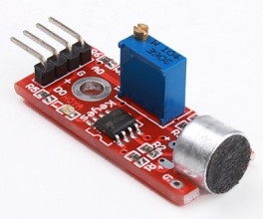
KY-038 Microphone Sound Sensor
Detect when sound has exceeded a set point
Sound is detected via a microphone and fed into an LM393 op amp
The sound level set point is adjusted via an on-board potentiometer
When the sound level exceeds the set point, an LED on the module is illuminated and the output is sent low

Slide 52
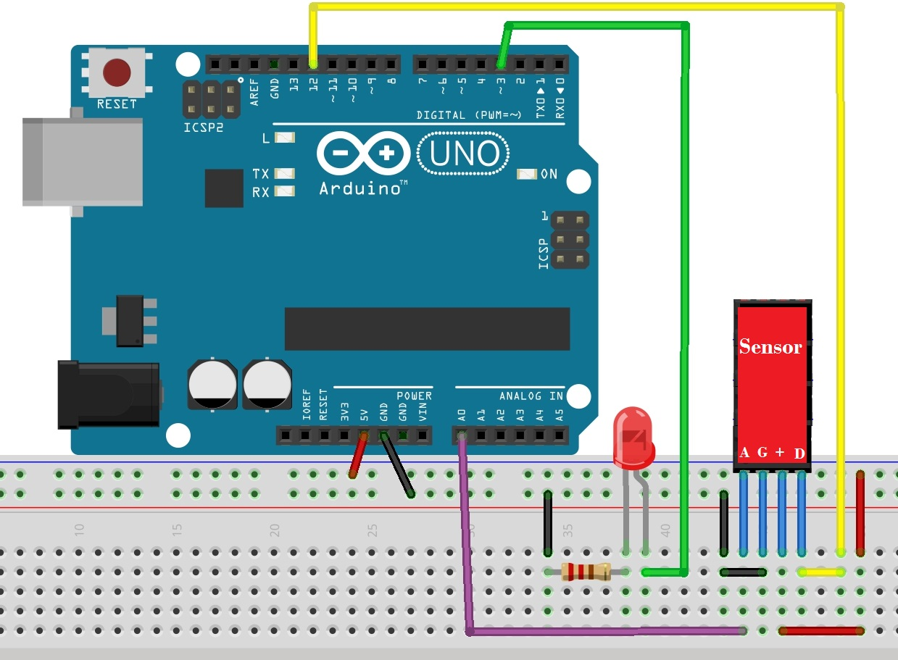
KY-038 Microphone Sound Sensor
Module has four outputs: (inputs to Arduino)
AO, analog output: real-time output voltage signal of the microphone
DO, digital output: when the sound intensity reaches a certain threshold, output high and low signal
Vcc
GND

Slide 53
Sample Code for Microphone Digital Input
int Led = 13
int sensorpin = 12;
int val = 0;
void setup() {
pinMode(Led, OUTPUT);
pinMode(sensorpin, INPUT);
}
void loop() {
val = digitalRead(sensorpin);
/* digital interface will be assigned a value of
pin 12 to read val */
if (val == HIGH) { digitalWrite(Led, HIGH); }
else { digitalWrite(Led, LOW); } }

Slide 54
Sample Code for Microphone Analog Input
int sensorPin = A0;
int ledPin = 13;
int sensorValue = 0;
void setup() {
Serial.begin(9600);
pinMode(ledPin, OUTPUT);
}
void loop() {
sensorValue = analogRead(sensorPin);
digitalWrite(ledPin, HIGH);
delay(sensorValue);
digitalWrite(ledPin, LOW);
delay(sensorValue);
Serial.println(sensorValue, DEC);
}

